Slide 1

Virtual World Modeling Technology

Slide 2

VWMT.
VWMT – Virtual World Modeling Technology – is a tool oriented on the creation of virtual worlds.
SapienZ and other entities form a single virtual world.
The whole world, the world habitat of catfish and his inner world –
form a single world .
M. Escher “Three Worlds”

Slide 3
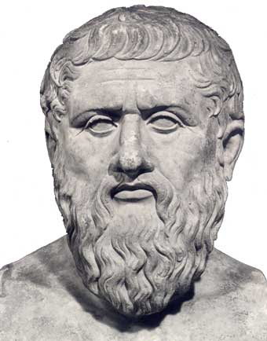
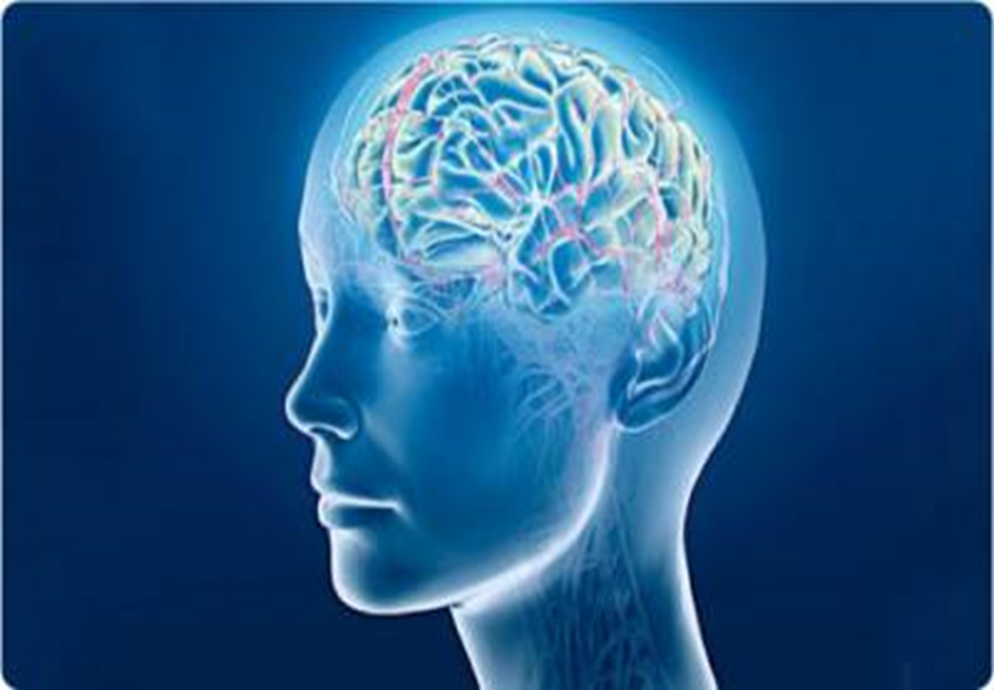

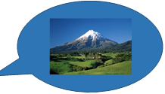
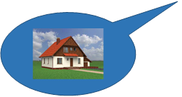
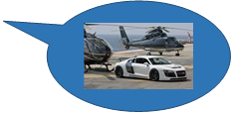
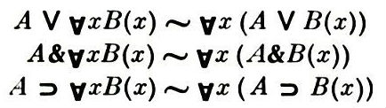
The concepts of worlds.
Plato worlds
«Material» worlds
Mathematical logic
Ideal, perfect world
ϕ - shadow
The shadow of the ideal world.
Real entities
World reflected in the mind
ϕ - image
Real world
Formal theory
(ideal world)
ϕ - interpretation
The model of formal theory

Slide 4
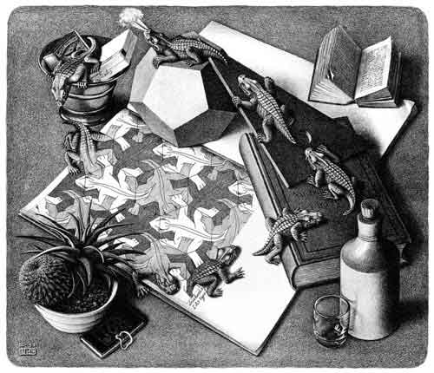
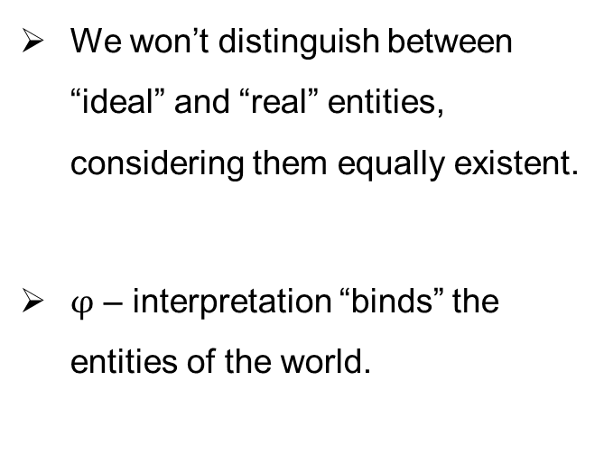
Our approach.
The entities of the world
ϕ - interpretation
We won’t distinguish between “ideal” and “real” entities, considering them equally existent.
$φ$ – interpretation “binds” the entities of the world.

Slide 5
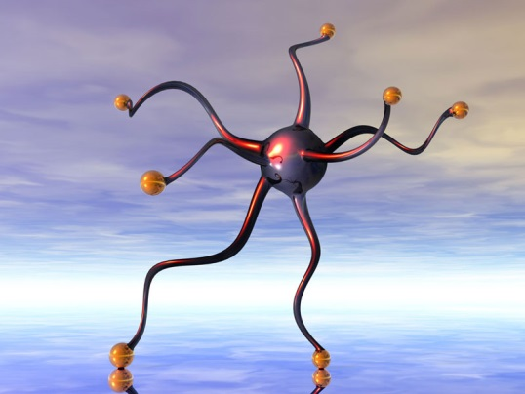
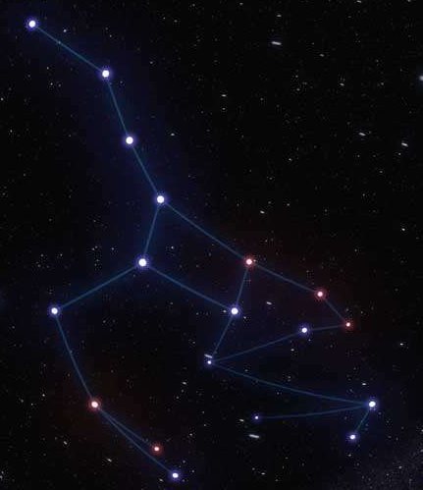
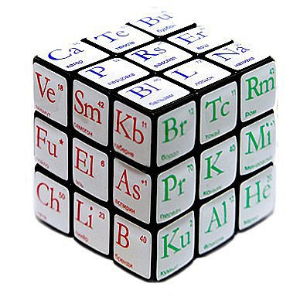
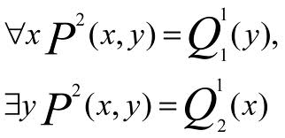
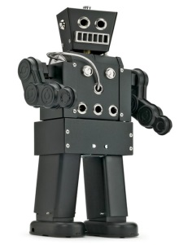
Virtual Worlds. Entities.
Idea, plan or intention, image, fantasy, abstract concepts, fictional characters – all these are entities.
Contemplating the “holistic” world, we highlight some individuals in it, objects which are perceived and conceived as something whole.
Entities are both ideal and real objects, which can be thought as the whole.
The relationships between entities, properties, names and descriptions of entities are also called entities.

Slide 6
SapienZ inhabiting the virtual worlds.
SapienZ are able to perceive the world and they have memory that reflects their knowledge of the world.
SapienZ analyzes the world, changes it initiating various events.
SapienZ has a variety of behavioral strategies.
Any events, i.e. any changes in the virtual world occur at the behest of one or another intelligent being – SapienZ, inhabiting this world.

Slide 7
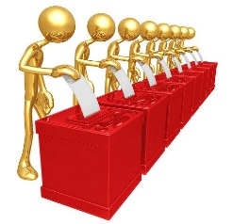
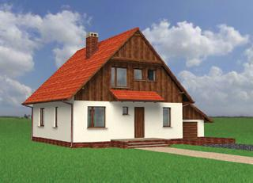

Changes of the interpretation of entities. Events.
ϕ
(President USA)
Bush
If a person or idea was born, it started to rain, Abraham married Sarah, the house was built, the president was elected… - all this means that the event occurred.
Event – is a change of the interpretation of entity.
President
election
ϕ
(President USA)
Obama
ϕ
Street
(house1, house2)
Building
a new house
ϕ
Street
(house1, house2, house3)

Slide 8

Project of the virtual world.
VWML (Virtual World Modeling Language)
Entities of the virtual world
Interpretive expressions which “bind" different entities
Behavior of intelligent entities in the virtual world
Describing the initial state of the virtual world and the events occurring in it, we are modeling the evolution of the virtual world.
Conversion of VWML project
The description of the virtual world on the problem-oriented language VWML is converted into the java code (or other object-oriented code).
VWML
Java

Slide 9

Parallelism.
The concept of semantic parallelism
The approach is based on the planning of “intelligent”, “concerted” behavior of the SapienZ in the virtual world.
Before changing the world, SapienZ overlook it and decide “for himself” whether to do it, if yes – then how.
If it is necessary, the dialogue with other SapienZ is possible.

Slide 10
The development process.

Slide 11
Thanks for attention!

